Slide 1
2G Innovation and
Networking Event 2026

Slide 2
Welcome to 2Gether
Thank you for accepting our invitation to Heek. Two full days, a working factory, and the people who build, commission and service our fleet. No gloss.
This is how we introduce 2G to the consultants and decision makers shaping the UK energy transition. You will see our engines on the line, our service workshop in flow, and the Green Cube heat pump concept at scale.
You will hear from our own engineers on island mode, gas blending and BESS integration, and from external experts on capacity market, gas strategy and project finance.
Expect specifics, not slogans. Ask hard questions.
Four things you will leave Heek with.
A clear view of the UK proposition
CHP, heat pumps, financing, turnkey.
A clear view of the UK proposition
CHP, heat pumps, financing, turnkey.
Product depth,
first-hand
Manufacture, service, commissioning.
Commercial context
Capacity market, gas strategy, CO₂ assessment.
Commercial context
Capacity market, gas strategy, CO₂ assessment.
Technology you can specify
Island mode, gas blending, BESS.
Technology you can specify
Island mode, gas blending, BESS.

Slide 3
Arrival, Welcome and a Tour of the Works
Time | Programme | Info
12:00 | Shuttle transfers from Dusseldorf | 2G shuttle to Heek. Pickup times to be confirmed
14:00 | Welcome at 2Gether | Coffee, snacks and informal arrival
14:30 | Welcome and introduction to 2G | Mark Holtmann, 2G Energy UK 20 min + 10 min Q&A
15:00 | Capacity market and frequency response | Ian Capper, ENEL 20 min + 10 min Q&A
15:30 | CHPQA, CCL and CPS considerations | NowThenEnergy, Tim Pratt 20 min + 10 min Q&A
16:00 | Company tour and service workshop | Works floor, closing with refreshments
18:00 | Tractor-drawn wagon to the hotel | Countryside route through Heek
20:00 | Dinner and open bar at the hotel | Informal conversations with the 2G team

Slide 4
Arrival, Welcome and a Tour of the Works
Time | Programme | Info
09:00 | Welcome and framing the day | Mark Holtmann, 2G Energy UK.
09:05 | CHP and economic considerations | Giles Vidgeon, 2G 30 min + 10 min Q&A
09:45 | Heat pumps, 2G USPs and Green Cube concepts | Ulrich Brinkmann, 2G 30 min + 10 min Q&A
10:25 | Coffee and informal discussion | 2Gether foyer.
11:00 | Gas costs and purchasing strategy | Ian Edwards, TED Generation 2 Ltd 20 min + 10 min Q&A
11:30 | 2G Data Centre solutions | Giles Vidgeon, 2G 20 min + 10 min Q&A
12:00 | Lunch | 2Gether dining room.

Slide 5
Arrival, Welcome and a Tour of the Works
Time | Programme | Info
12:45 | Gas blending, from flare ban to dispatchable fuel | Mark Holtmann, 2G 20 min + 10 min Q&A
13:15 | CHP and heat pump island mode coverage | Jon Dean, 2G · what to look out for 20 min + 10 min Q&A
13:45 | 2G BESS systems, what to consider | Jon Dean, 2G · industry landscape 20 min + 10 min Q&A
14:15 | Coffee, key takeaways and close | Mark Holtmann, 2G Energy UK.
14:45 | Shuttle transfers to Dusseldorf | 2G shuttle departs Heek.

Slide 6
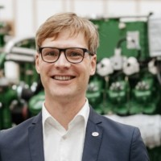
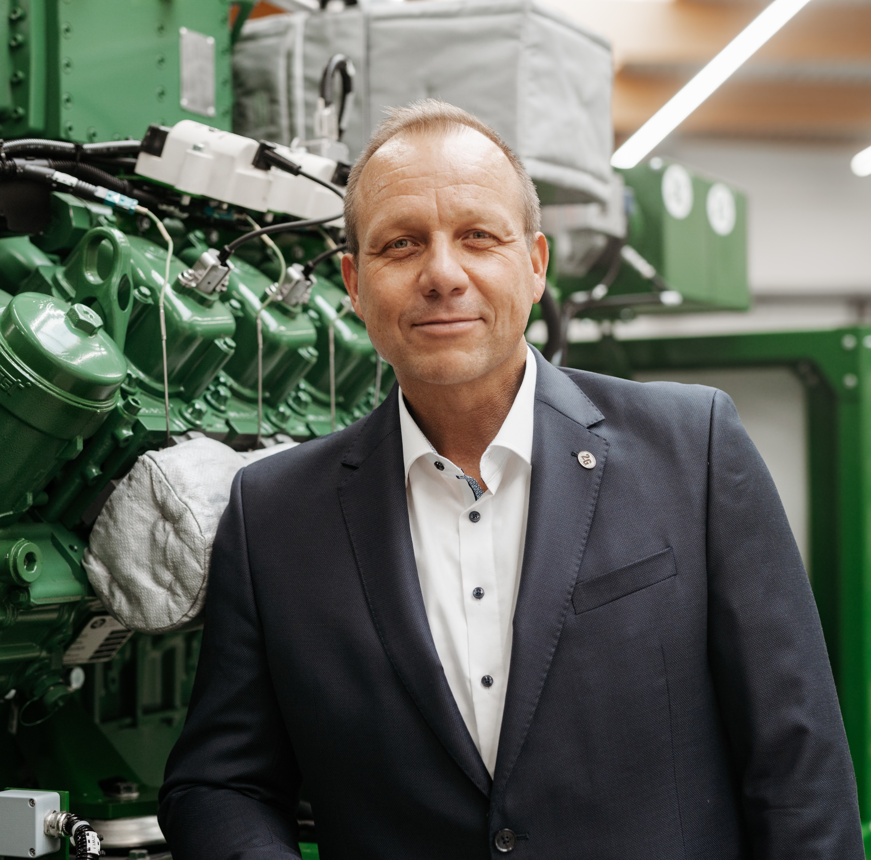
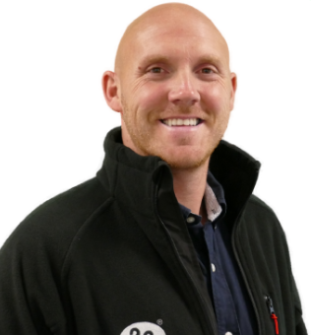
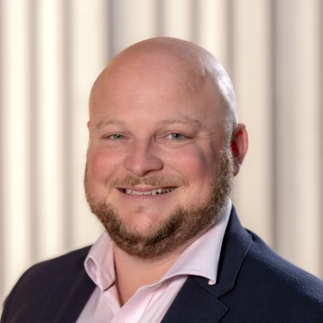



Your Hosts and Speakers
Mark Holtmann
Ulrich Brinkmann
Jon Dean
Managing Director
Heat pumps & afilia range
Head of Operations
Welcome, introduction to 2G, and the gas blending session.
Heat pumps, afilia range and
Green Cube concepts.
Island mode coverage and
2G's view on BESS.
Giles Vidgeon
Enel X | TED | NowThenEnergy
Commercial
Ian Capper · Ian Edwards · Tim Pratt
CHP economics, UK context and commercial structuring.
Capacity market, gas strategy, CO₂ , CHPQA, CCL and CPS considerations
2G INNOVATION AND NETWORKING EVENT · HOSTS
06 / 08

Slide 7
Thank you very much
for your attention

